Slide 1
Name: M.GOKILA
NM id: au730321104011
Reg. No: 730321104011
Year: III
Department: BE/COMPUTER SCIENCE AND ENGINEERING
College Name: BUILDERS ENGINEERING COLLEGE
3/21/2024
Annual Review
1

Slide 2
PROJECT TITLE
TEXT TO SPEACH RECOGINITION
3/21/2024
Annual Review
2

Slide 3

1. Introduction to Text to Speach Recoginition.
2. Technologies and Tools.
3. Hardware Requirements.
4. Software Development
5. Algorithm.
6. Use Cases and Applications.
7. Conclusion.
AGENDA
3/21/2024
Annual Review
3

Slide 4

PROBLEM STATEMENT
Text-to-speech technology plays a vital role in various applications such as virtual assistants, accessibility tools for visually impaired individuals, navigation systems, audiobook production, and more. The primary challenge lies in creating speech synthesis systems that produce high-quality, intelligible, and natural-sounding speech from textual input across different languages and accents.
KEY CHALLENGE
Naturalness
Real-Time-Processing
Adoptability
Customization
3/21/2024
Annual Review
4

Slide 5

PROJECT OVERVIEW
The input text undergoes preprocessing to handle punctuation, special characters, and formatting inconsistencies.Software developed using Python.
The synthesized speech is generated based on the input text and the acoustic models.
Some TTS systems offer the ability to customize speech characteristics such as voice pitch, speed, and style to suit user preferences.Media Pipe Framework – Hand Gesture Tracking.
User feedback and subjective evaluations also play a crucial role in assessing the performance of TTS systems.
3/21/2024
Annual Review
5

Slide 6

WHO ARE THE END USERS?
1. Individuals with Visual Impairments
2. Accessibility Tools
3. Language Learners
4. Virtual Assistants and Chatbots
5. Navigation and GPS Systems
6. Audiobook and Podcast Consumers
7. Language Translation and Localization
8. Assistive Technology Users
3/21/2024
Annual Review
6

Slide 7

SOLUTION AND ITS VALUE PROPOSITION
Solution:
Design and implement a text-to-speech recognition system leveraging state-of-the-art techniques in natural language processing (NLP), machine learning, and speech synthesis.
Value Proposition:
Evaluate the proposed TTS system using standard benchmark datasets and real-world use cases. Assess the system's performance in terms of speech quality, intelligibility, computational efficiency, and user satisfaction.
3/21/2024
Annual Review
7

Slide 8

THE WOW IN SOLUTION
1. Text Preprocessing
2. Linguistic Analysis
3. Acoustic Modeling
4. Neural Network Architecture
5. Training Data
6. Evaluation Metrics
7. Deployment
3/21/2024
Annual Review
8

Slide 9
Relationships
WaveNet: A deep generative model that directly models the raw waveform of speech.
Tacotron: A sequence-to-sequence model that generates mel spectrograms from text, followed by a vocoder to synthesize speech.
Transformer-based models: Leveraging self-attention mechanisms, transformer-based models like Transformer-TTS or FastSpeech can generate speech directly from text.
Evaluate the trained model on the validation set using metrics such as Mean Opinion Score (MOS), signal-to-noise ratio (SNR), or perceptual evaluation of speech quality (PESQ).
MODELLING
3/21/2024
Annual Review
9

Slide 10
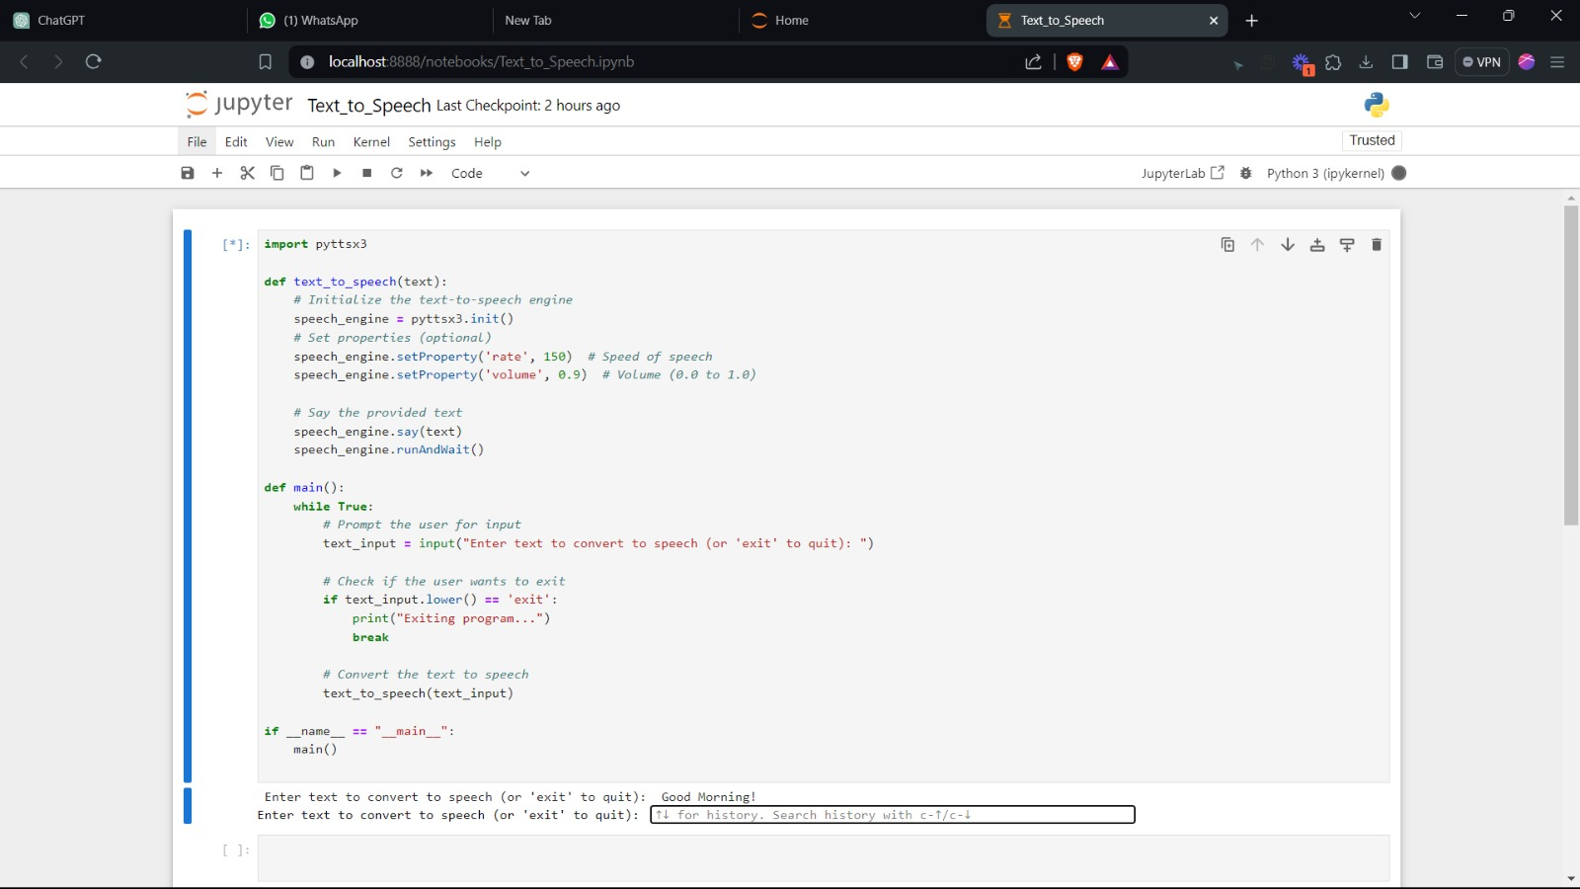
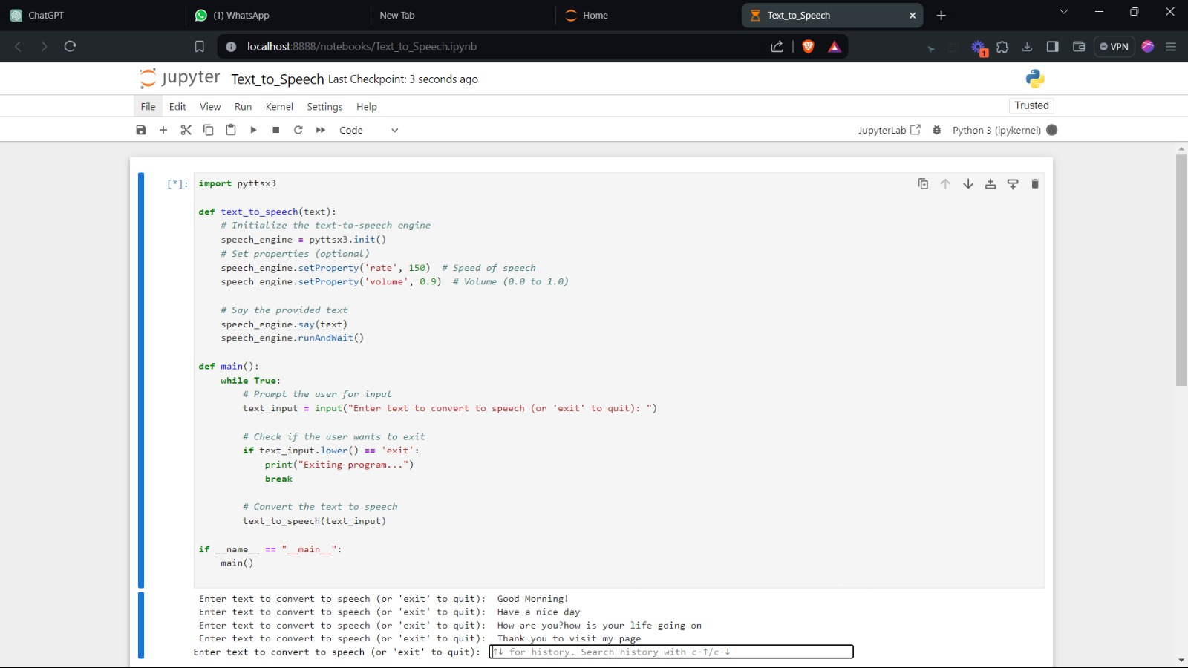
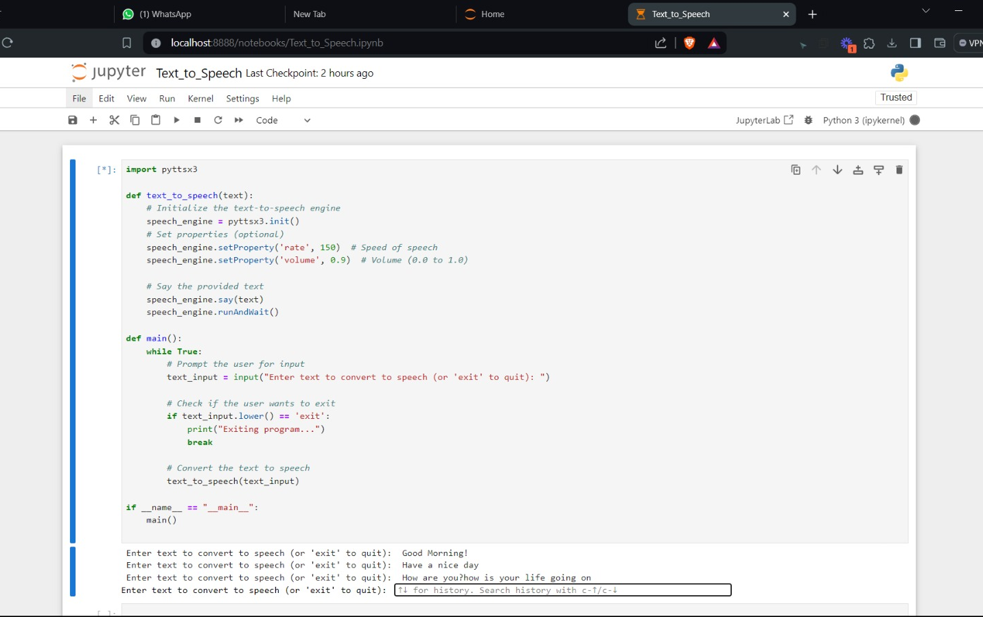
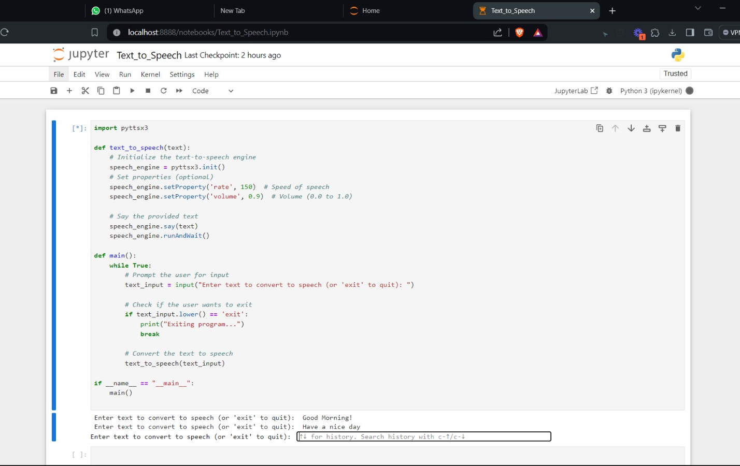
RESULTS
DEMO LINK
https://www.loom.com/share/323c9d22732940068ad98fa5d49284c3?sid=88c145b8-df07-4bb9-9f82-0f69e70b7998
3/21/2024
Annual Review

